Slide 1
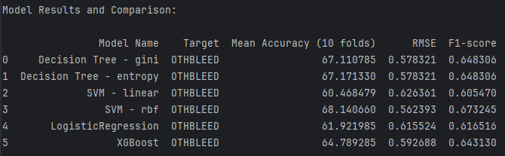
Model Performance (20 f.) – First Week

Slide 2
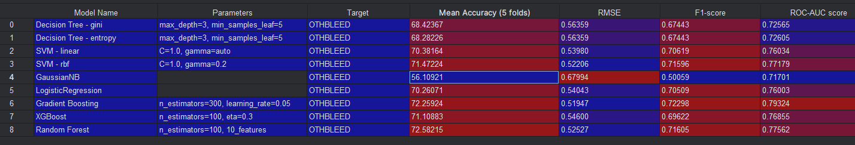
Model Performance
(Better imputation; 43 features selected by Dr. Gupta)
Best model
2nd Best model

Slide 3
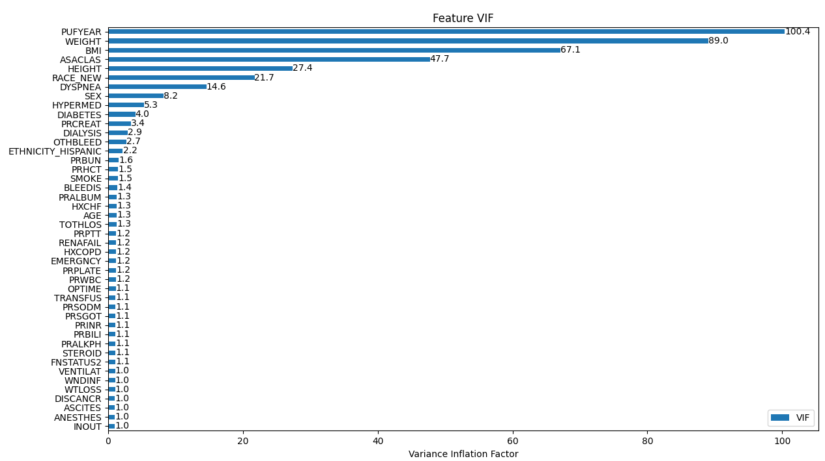
Detecting Multicollinearity

Slide 4
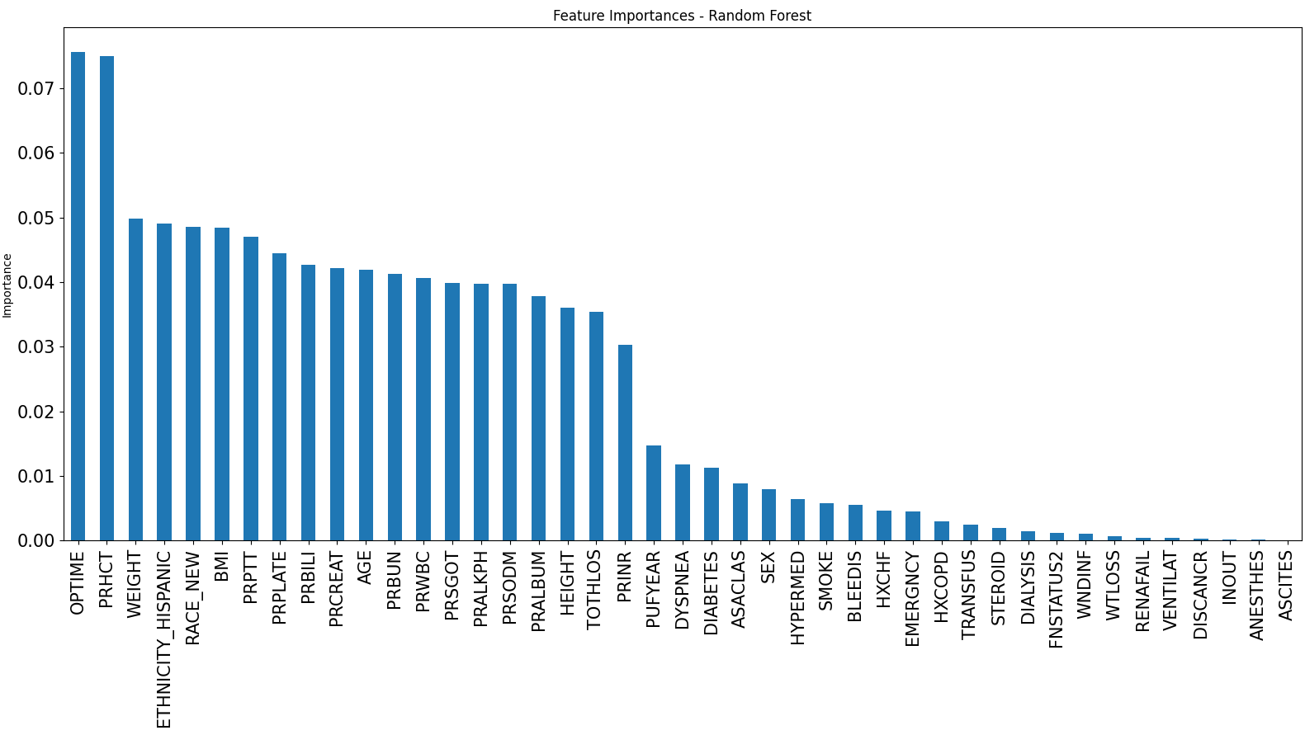
Random Forest (features included = 43)

Slide 5
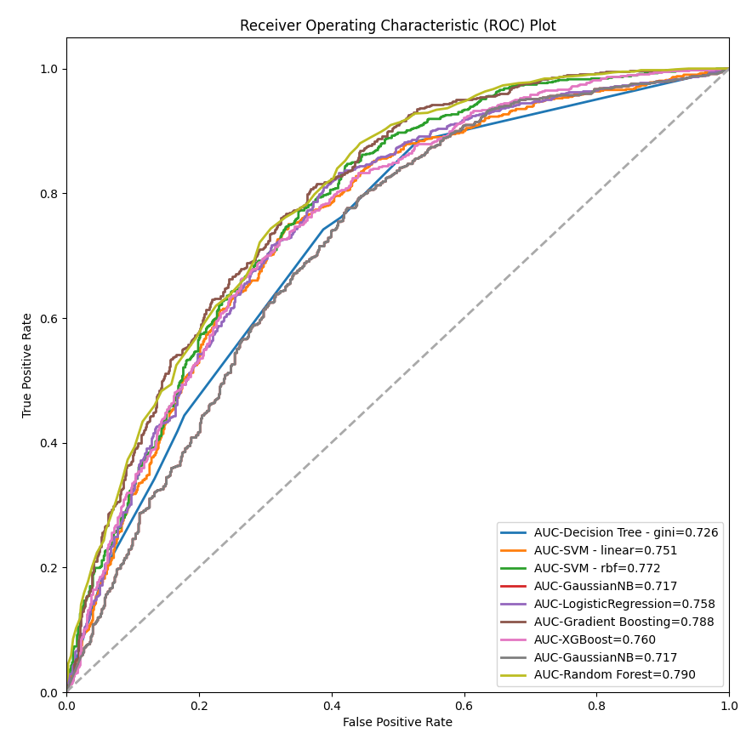
ROC-AUC Comparison (models included = 9)

Slide 6
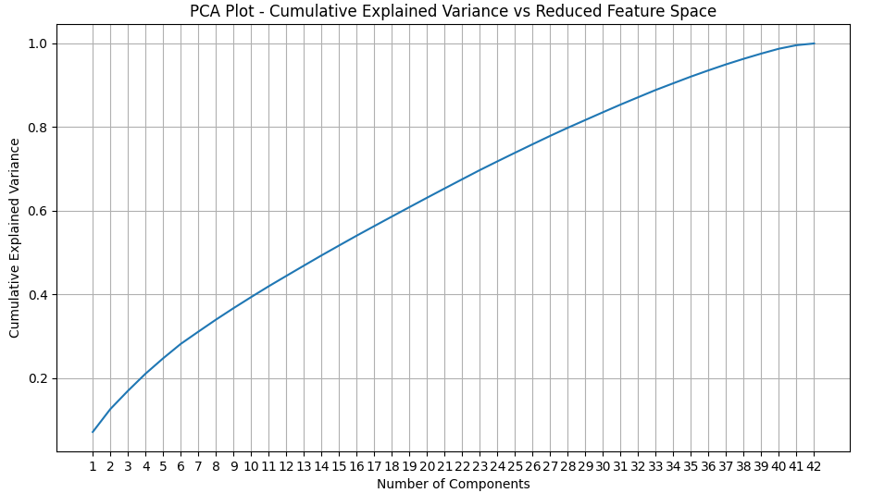

Feature Selection – PCA

Slide 7
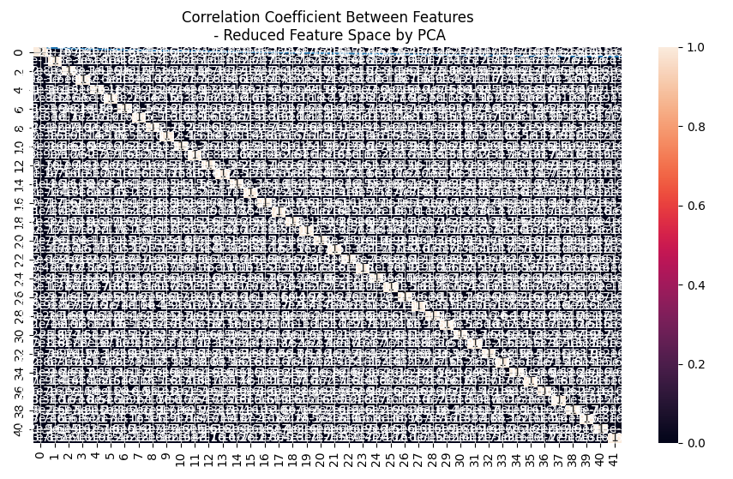
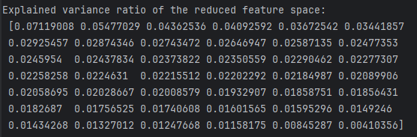
Feature Selection – PCA
Explained Variance Ratio

Slide 8
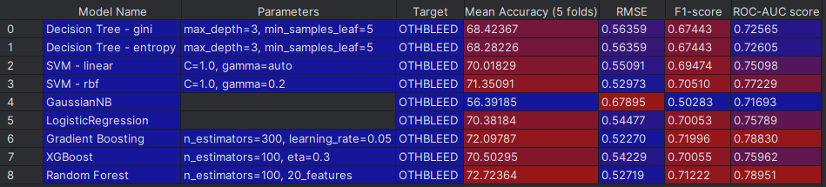
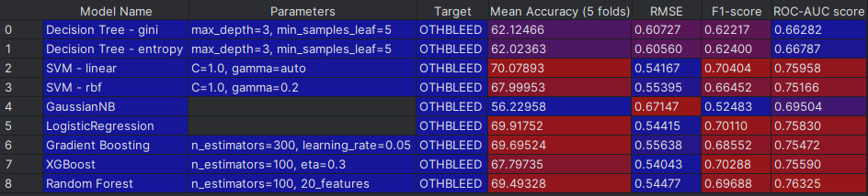
Model Performance (43 f.) – Before Feature Selection
Model Performance (42 f.) – After Feature Selection
Best model
2nd Best model

Slide 9
Backup Slides

Slide 10
Class
class_baseline_decision_tree
DecisionTree
class_baseline_svm
SVM
class_baseline_logistic
LogReg
class_baseline_xgboost
XGB
Utilities
utils_models

Slide 11
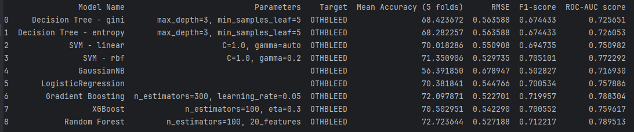
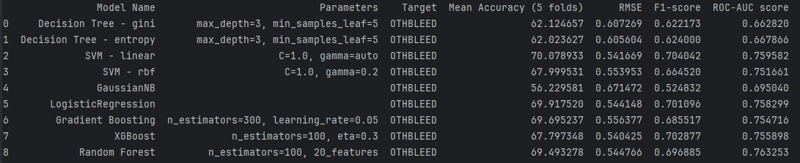
Model Performance (43 f.) – Before Feature Selection
Model Performance (42 f.) – After Feature Selection

